Slide 1
Summarizing A Poem

Slide 2
When we summarize a poem—or any other text for that matter—we rewrite it in our own words, reducing it to its key points, its most important information.

Slide 3
A graphic organizer such as a linear string chart is one way to help you summarize a poem.

Slide 4
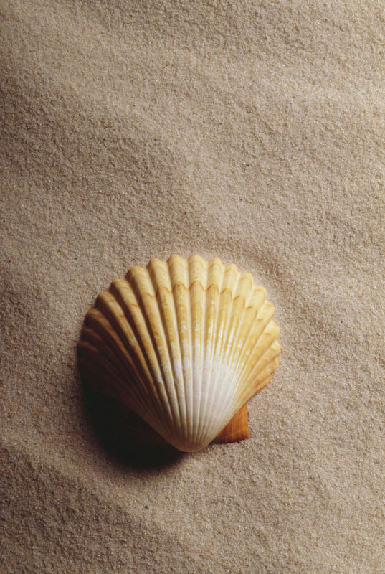
We will now see an example of a linear string chart summary of E.E. Cummings poem, “10” (Maggie and Milly and Molly and May).
Click on the starfish to go to the poem.

Slide 5
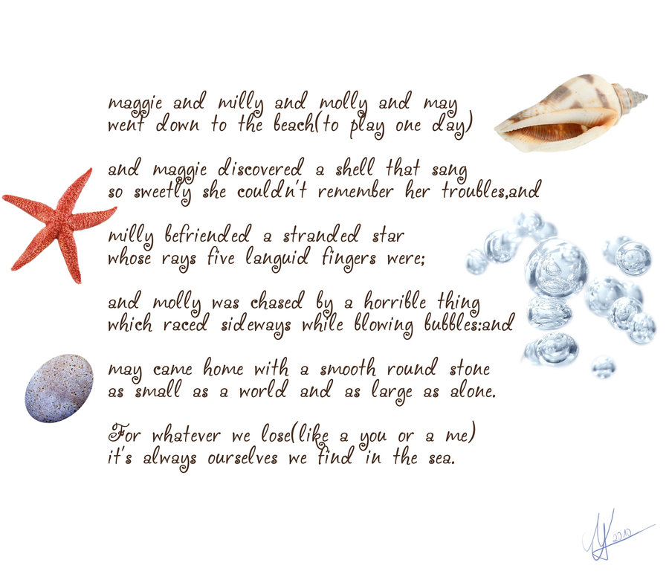

Slide 6
First, the four girls go to the beach to play.
Maggie finds a seashell, and she listens to the sound it makes.
Milly finds and helps a starfish.
A crab chases Molly, and frightens her
May finds a smooth stone and takes it home.
Finally, the speaker concludes by making a profound statement: that going to the sea is a way to get in touch with who we really are.

Slide 7
Now that you have read the poem and seen a summary done using a linear string chart, choose a poem, and try it yourself.

