Slide 1
The Signalman
8D
presents to you
Analysis of

Slide 2
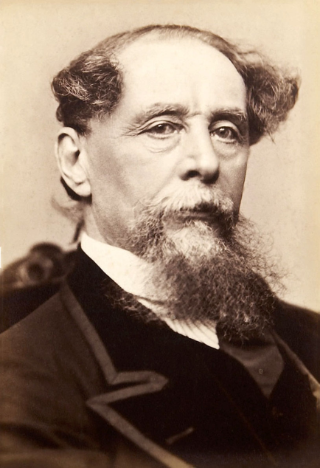
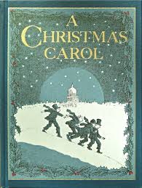
About Charles Dickens
Vivid characters and overall descriptions
Life of ‘rags to riches’
Born Portsmouth- 7th February 1812
John and Elizabeth Dickens
Theatre fanatic
Lectures on slavery
Separated from wife after 10th child
Died of stroke in 1870
Victorian Author

Slide 3
Origin of ‘the Signalman’
"The Signal-Man" is a short story by Charles Dickens, first published as part of the Mugby Junction collection in the 1866 Christmas edition of All the Year Round.
It is likely that Dickens based this incident on the Clayton Tunnel crash that occurred during the Industrial Revolution in 1861, five years before he wrote the story. He had experienced this traumatic incident and was unable to speak for more than two weeks after it.

Slide 4
Sequence of Events

Slide 5
The story begins with the narrator calling to the signalman “Halloa! Below there!”.
The narrator asks him if there is any way he can come down.
Then, the signalman looks up at him and points out a path which the signalman can use to come down.
They are frightened of each other
The signalman then believes that they might have seen each other before. Narrator denies.
Signalman agrees and talks a little about his post.
Then they both go inside the signalman's box.
Signalman starts to talk about his youth and education. (credibility)
Narrator is about to leave. Signalman invites him over again. He wants to tell the narrator something.
Signalman asks if the call “Halloa! below there” was sent to him by supernatural means. Narrator denies.

Slide 6
The next evening the narrator is at the signalman’s box
The signalman tells the narrator he has made up his mind to confide in him
The signalman talks about the first apparition he saw and imitates the spectres’ actions
He then informs the narrator that the ‘memorable accident’ happened 6 hours after he had seen the apparition
Next, the signalman discloses that some time after he had seen apparition the second time, a young lady died in one of the compartments of a train
The signalman later mentions how he has been seeing the spectre again and again for the past week
The Signalman tells the narrator about the spectre/ghost he saw at the Danger Light.
The narrator then asks him if he could see the spectre where the Signalman saw it first but, there appears to be nothing.

Slide 7
He is helpless in this matter and the narrator feels concerned and worried for him.
He then tries to calm the signalman down and leaves the box at two in the morning even though he did offer to stay the night.
On his way home, the narrator thinks about the apparitions and about what the signalman said.
Page 25 ends with the sentence “I had appointed to return accordingly.”
He notices the appearance of a man, with his left sleeve across his eyes, waving his right arm but realizes it was actually a man, not a spectre.
Engine driver explains to him how the signalman died. The narrator notes the similarity between the driver's actions and the actions of the spectre as the signalman had earlier described them, but leaves the nature of that significance to the reader.
There are still many possibilities of his death as it isn’t stated clearly in the story.

Slide 8
Tone & Atmosphere

Slide 9
Tone
Tone:
Formal: The writer uses a formal tone in the short story “The Signalman”
This is clearly apparent in the lines, “My good fellow, what should I do there?”
The tone is very formal as both, the signalman and narrator refer to each other as ‘sir’. “He threw in the word ‘Sir’ from time to time, and especially when he referred to his youth-”
And, “but I am troubled, sir, I am troubled.”
And, “I have made up my mind, sir.”

Slide 10
Helpless: He feels helpless because he knows danger is lurking nearby but does not know what to do about it.
This is evident in lines “ His pain of mind was most pitiable to see. I t was the mental torture of a conscientious man, oppressed beyond endurance by an unintelligible responsibility involving life.”
And, “An I, Lord help me! A mere poor signalman on this solitary station! Why not got to somebody with credit to be believed, and power to act.”
And also, “Some dreadful calamity will happen. It is not to be doubted this third time, after what has gone before. But surely this is a cruel haunting of me. What can I do?”

Slide 11
Atmosphere
Gloomy: The atmosphere and the surroundings in short story, The Signalman are predominantly gloomy, eerie, or depressing. This is evident in descriptions the author has provided, like comparing the tunnel to a ‘great dungeon’.
“; the shorter perspective in the other direction terminating in a gloomy red light , and the gloomier entrance to a black tunnel.
Phrases like “Barbarous, depressing and forbidding air” also add to the overall image of depression and gloom.
Also, “Was it necessary for him when on duty always to remain in that channel of damp air, and could he never rise into the sunshine from between those high stone walls?”

Slide 12
Atmosphere
Suspenseful: During the short story, Dickens has incorporated a large amount of suspense- evident in lines
“On both those occasions he came back to the fire with the inexplicable air upon him which I had remarked, without being able to define, when we were so far asunder.”
And, “With what? What is your trouble?
“It is very difficult to impart, sir. It is very, very difficult to speak of. If ever you make me another visit, I will try to tell you.”
“Some dreadful calamity will happen.”
Note: But towards the end there is an entire change of tone and atmosphere- relaxed and then confusion

Slide 13
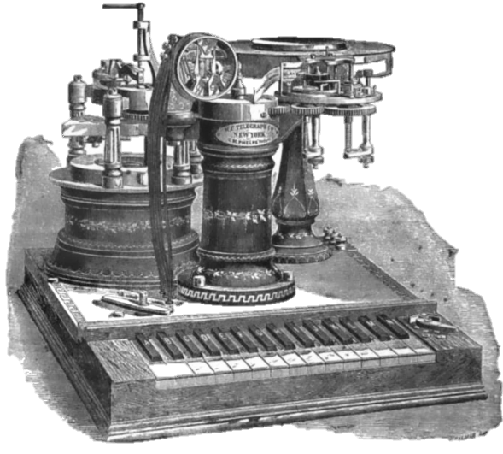
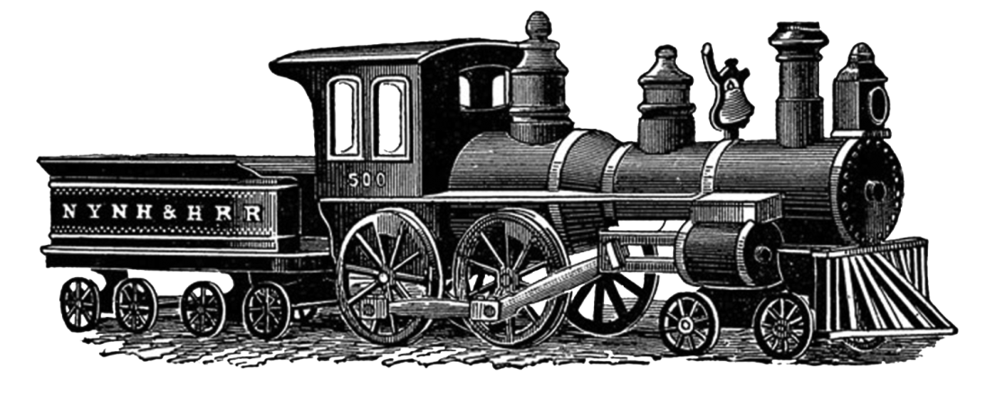
Themes

Slide 14
Themes
1. Loneliness/ Social Isolation
“His post was in a solitary and dismal a place as I ever saw.”
“A mere poor signal man on this solitary station.”
“… he merely saw a man who had been shut up within narrow limits all his life…”
2. Supernatural
“…as I perused the fixed eyes and the saturnine face, that this was a spirit, not a man.”
“I have never confused the spectre’s ring with the man’s. The ghost’s ring is a strange vibration in the bell that it derives from nothing else.

Slide 15
Technology being the reason of helplessness
“As the engine came out the tunnel, his back was towards her, and she cut him down.
“I telegraphed both ways. ‘ An alarm has been given. Is anything wrong?’ The answer came back, both ways, ‘All well.’”

Slide 16
Character Development
Narrator
Skeptical of Signalman
Finds him reasonable as the story progresses
Becomes close- acquaintances (“My signalman”)
At his death- narrator is mortified and dpressed.
Signalman
Depicted as a ‘sallow man’
Then is built up as a literate and educated man
His helpless situation is revealed
His real state of mind is revealed
Past trauma is revealed

Slide 17
Symbols
Symbols:
The red danger-light:- Red signal light symbolizes danger or warning for red is the literary colour universally used for death, warning and danger.
The Apparitions:- The apparitions the signalman keeps seeing symbolize human beings caring and wanting to save each other but are helpless in the face of one’s pre-determined fate
The Train:- The train symbolizes the power of technology and how it has more power than human beings possess. ‘he was cut down by an engine’ proves it.
The signalman represents mankind because he wants to help but can do anything to prevent the inevitable.

Slide 18
Unanswered Questions
Why was the Narrator at the station in the beginning of the story?
Were the apparitions real or not?
How did the signalman die?

Slide 19
Main Idea
The main idea of the ambiguous short story 'The Signalman' is the contrast between the 'Real world ' and the 'Unreal world'.
Another main idea is human beings caring for each other but are helpless in the face of a persons pre-determined fate. An example of this is the signalman’s desire to help prevent the accident from happening but can not do much
Incompetence of technology is also a main idea. The train stopped 150 yards after the signalman had motioned for it to stop and in that time the lady had died.

Slide 20
Analytical Questions
Comment on the themes in ‘the Signalman’
How has Dickens built up the atmosphere?
Comment on how tone contributes to the atmosphere.
Discuss the signalman's character.
Discuss the use of symbols and images.
Comment on the themes of suspense and horror.
Comment on the theme of mystery and confusion.
Comment on the theme of social isolation.
How has Dickens portrayed man's desire to help one another.
How has Dickens portrayed the helplessness of man in the face of technology.

Slide 21
Thoughts of Class 8D on ‘The Signalman’

Slide 22
Ayesha J: ‘A delighting short story which provokes the readers to feel different emotions during story’
Mahgul K: ‘I really like it but hated the ending’
Eesha K: ‘I loved the story, but I hated when the signalman was helpless’
Zaina S: ‘Evokes emotion, absolutely wonderful’
Zainab A: ‘I really loved it. Really suspicious and the Signalman was fascinating’
Neha C: ‘It was interesting and the ending was too sad.’
Rida-e- Zainab: ‘The story was interesting at some parts. The death of the Signalman was shocking’
Nafisa S: ‘I really like it after understanding it.’
Marukh Z: ‘I liked the story very much’

Slide 23
Alizay C: ‘I really loved the story. It was awesome!’
Maheen E: ‘Interesting once you start understanding it’
Eeman A: ‘I enjoyed reading the story very much’
Ayesha A: ‘I enjoyed reading it’
Aiza A: ‘Eerie, very very eerie’
Eesha Y: ‘The ending was very tragic’
Iqra N: ‘It was an interesting story but the ending was tragic
Maryam G: ‘Very intriguing’
Aiza Z: ‘When I first read it, I thought it was too boring, but after understanding it, I found it very interesting
Mishal K: ‘It has lots of hidden meanings which were nice but otherwise it was kind of boring’
Hajra M: ‘Though a very complex piece of writing, once understood, “the Signalman” is an exciting, intriguing and suspenseful story’

Slide 24
Furheen S: ‘Even though it isn't love at first sight, once you really understand “The Signalman” it becomes exciting and you just fall in love with it’
Shehzmani S: ‘A very thrilling and eerie shortstory, very gripping.
Asna Q: ‘”The Signalman” is a very interesting story. Might not be fun if you’re reading it for the first time but, once you actually understand it, it is very enthralling’

Slide 25
8D would like to thank you for being such an amazing audience!
This presentation would not be possible without the contribution of our class
Aiza Atif
Aiza Zehra
Ayesha Aftab
Anya Aftab
Asna Qammar
Alizey Chohan
Ayesha Javaid
Ayesha Muneeb
Eesha Kashif
Eesha Yousf
Eeman Adnan
Furheen Shazib
Hajra Malik
Hira Ahmed
Iman Ahmed
Iqra Naveed
Mahgul Kamran
Marukh Zubair
Mishaal Khan
Maheen Elahi
Nafisa Sheryar
Neha Chaudry
Maryam Ghazala Mallick
Shireen Salman
Shehzmani Shams
Rida-e- Zainab
Zoha Kamal
Zainab Amir
And a special thank you to Shehzmani Shams for her efforts and contributions!

